Slide 1
Industrial electronics N5
(8080175)
Programme(s):Electrical engineering all groups
Lecturer(s): Mr hs mbele

Slide 2
Power supplies
Chapter 02

Slide 3
1. Learning outcomes
Be able to briefly describe with the aid of a diagram and perform calculations on the following:
  RC π filter
  LC π filter
  Simple capacitor filter
  REFERENCE DEVICE
  Voltage doubler
  Adjustable power supply

Slide 4
2. introduction
A power supply is a unit that supplies an electric power to a load.
It converts AC to DC in most applications
It is composed of four stages namely; transformer stage, rectifier stage, filter stage and regulator stage.
These stages work together to convert AC in DC to power the load connected into it.

Slide 5
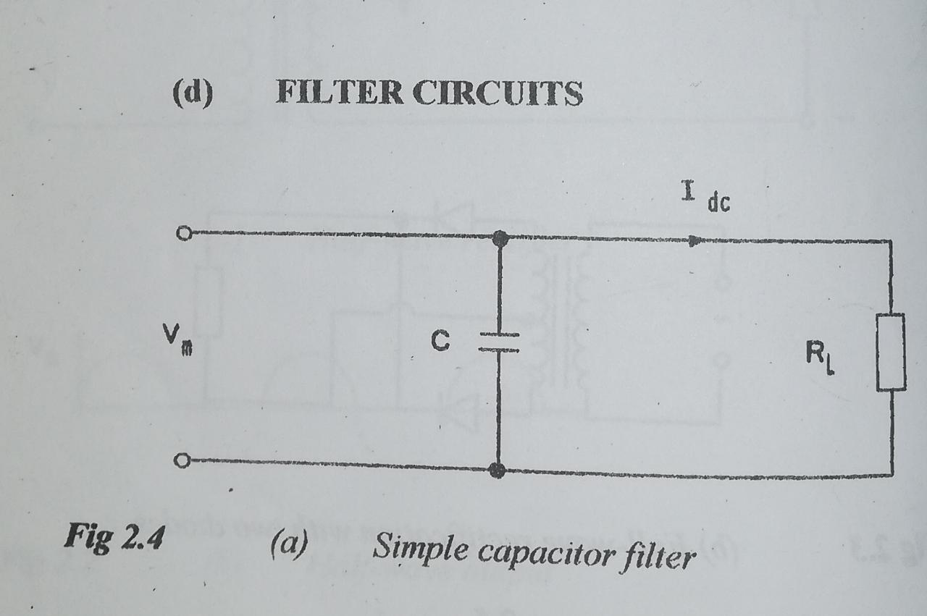
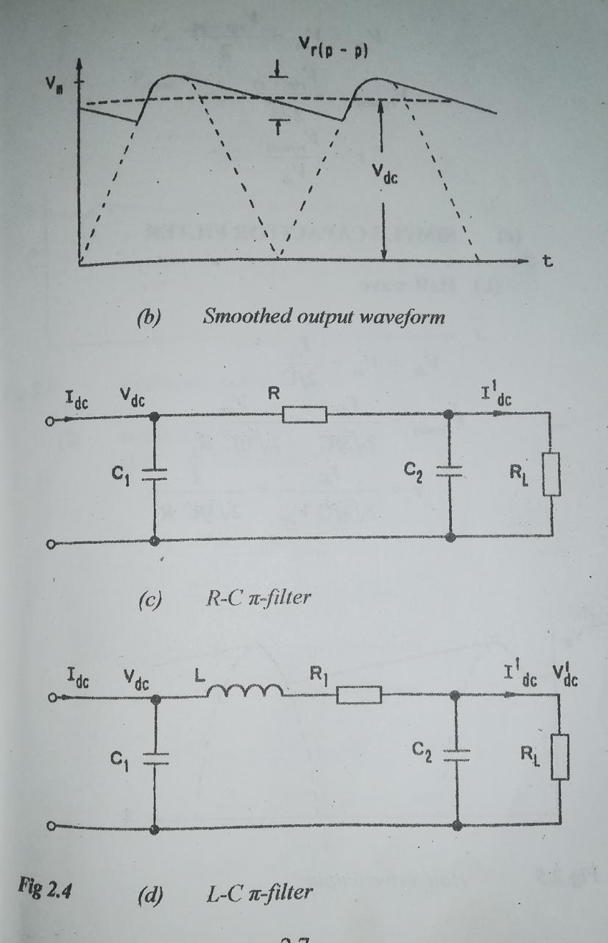
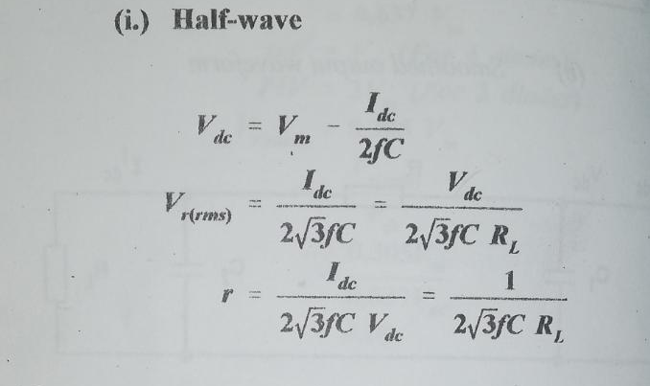
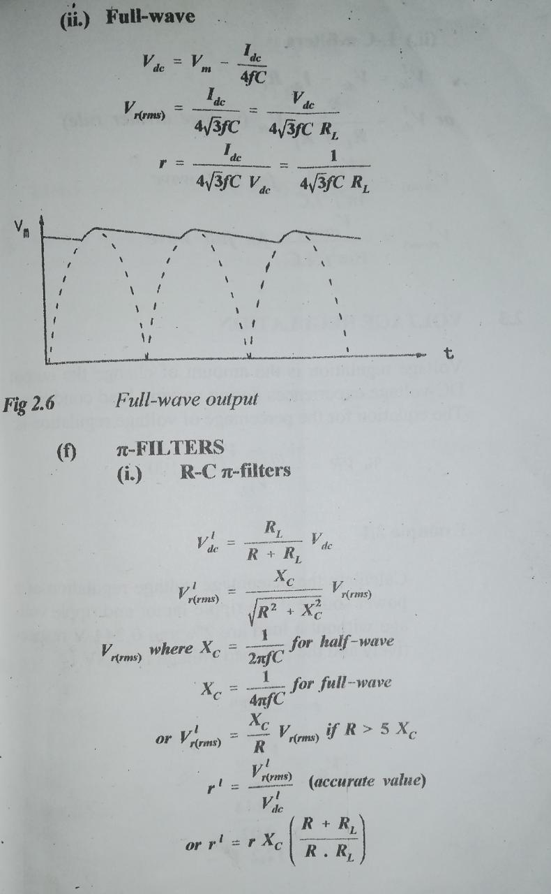
4.Simple capacitor filter
The simple capacitor filter

Slide 6
5.Rc π filter

Slide 7
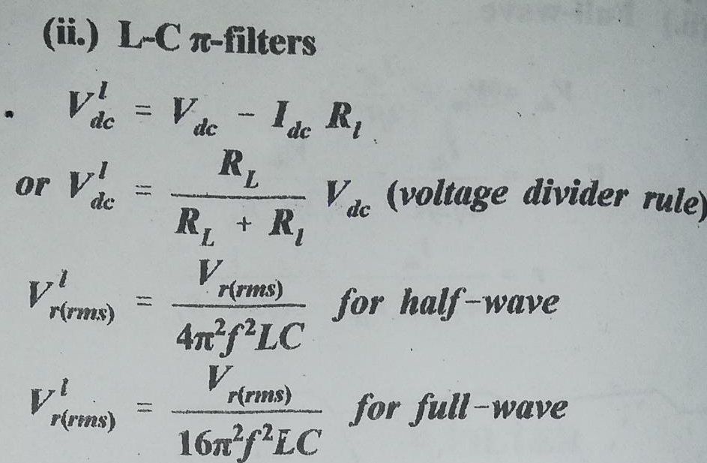
36.Lc π filter

Slide 8
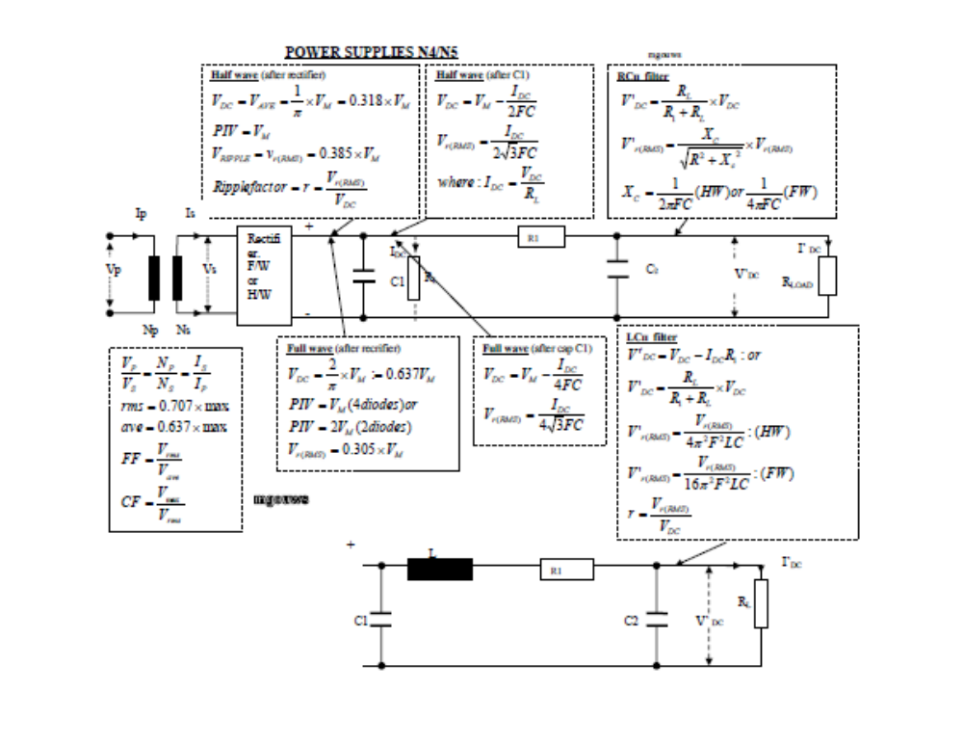

Slide 9
7.activity
Calculate the ripple percentage of a simple capacitor filter if the supply voltage is 15V, input direct current of 10mA, minimum supply frequency of 100 Hz after full wave rectification and a capacitor of 1000µF.
An RC π filter circuit has supply frequency of 50 Hz from a bridge rectifier, load resistance of 1.5KΩ, first capacitor of 470µF and second capacitor of 47µF , series resistor of 10Ω, input direct voltage of 16V and input ripple voltage of 1.8V. Calculator;
  Output voltage
  Output ripple voltage
  Input ripple factor
  Output ripple factor

Slide 10
8. solution

Slide 11
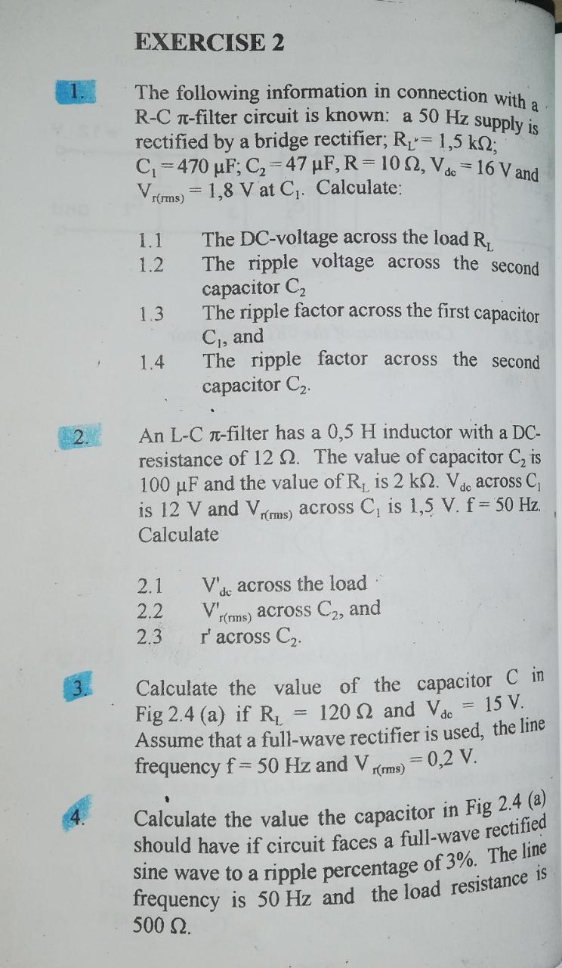
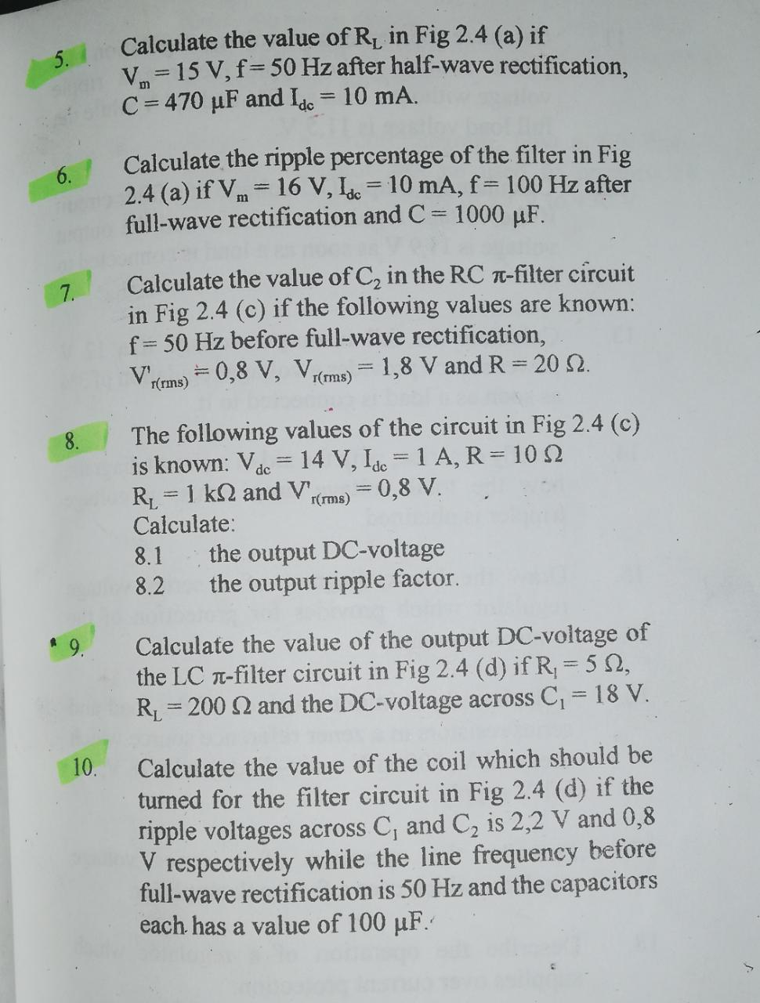
9. Additional resources

Slide 12
10. REGULATOR
Voltage regulation is the amount of change the output DC voltage experiences during varying load conditions.
When the output voltage is lower than the required voltage by the load, voltage multipliers are a requirement.
These voltage multipliers make used of capacitors and PN junction diodes
It is advisable that you have an understanding of the operation of a diode before going through this section.

Slide 13
11.The voltage regulator
%Voltage regulation
%Voltage regulation is the amount of change the output DC voltage experiences during varying load conditions.
Regulator
An electronic device found in power supplies that maintains the output voltage constant irrespective of the load changes.
Types of voltage regulators
Series regulator
Shunt regulator

Slide 14
Five major elements of a series voltage regulator
The reference element.
The feedback element.
The comparator.
The optional protective element.
The control element.

Slide 15
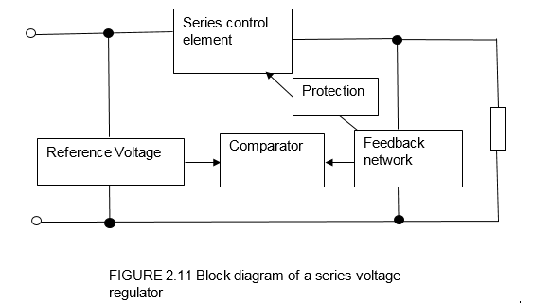
15.The block diagram of a series voltage reg

Slide 16
The elements explained
The control element
The function of the control element is to regulate the output voltage.
Part of the output voltage is fed back by a voltage distributor to a comparator where it is compared with the reference voltage.
Difference of the two voltages is fed back to the control element.
The degree of stabilizing during a voltage regulator is called a stabilizing factor and is determined by : S $=\frac{∆Vo}{∆Vi}$
The reference source
This element makes use of a Zener diode which regulates as long as the input voltage is greater than the Zener voltage hence a series resistor is a requirement to absorb the voltage difference.

Slide 17
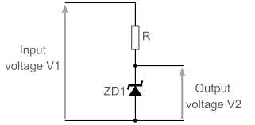
The circuit diagram of a Zener reference device
If the input voltage changes, voltage across the resistor will also change but the voltage across the diode remains constant. But the Zener current will change.
To protect the circuit against excessive current, minimum value of the series resistor and the load resistor must be known.
$R_{s(min)}=\frac{Vin\left(\max{}\right)−Vz}{Iz(\max{})}$ $R_{l(min)}=\frac{Vz}{Vin\left(max\right)−Vz}× R_{s}$

Slide 18
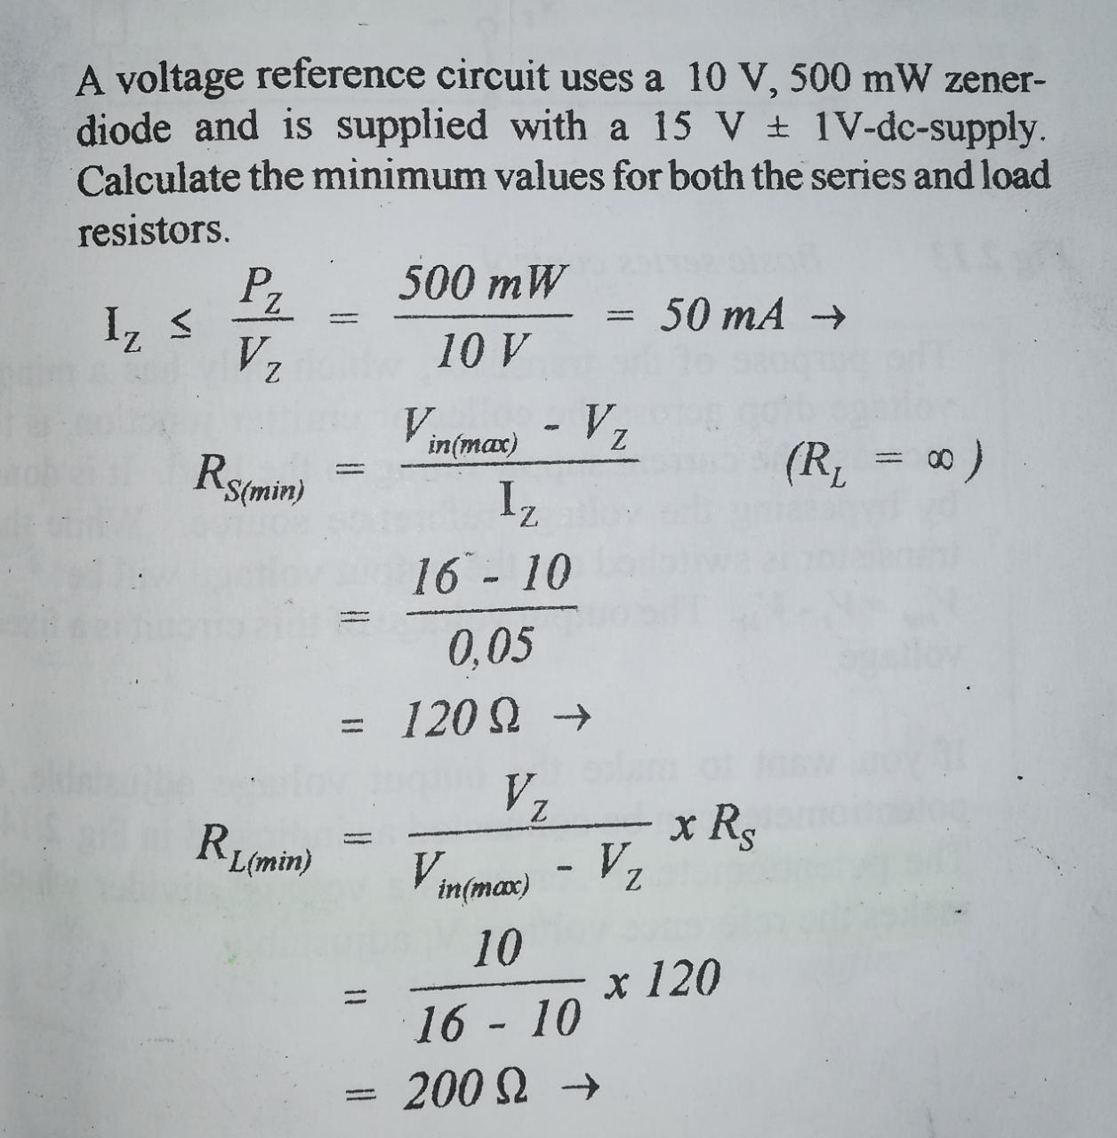
18.example

Slide 19
19. activity
Calculate the minimum values of the load and series resistors in a Zener reference source which uses a 12V, 500mW Zener diode and a 18V ±1V supply.

Slide 20
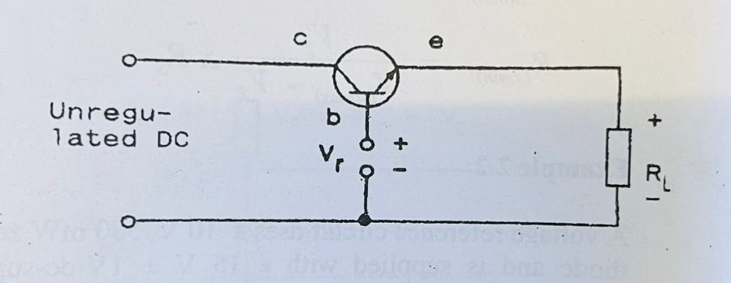
Basic series voltage regulator

Slide 21
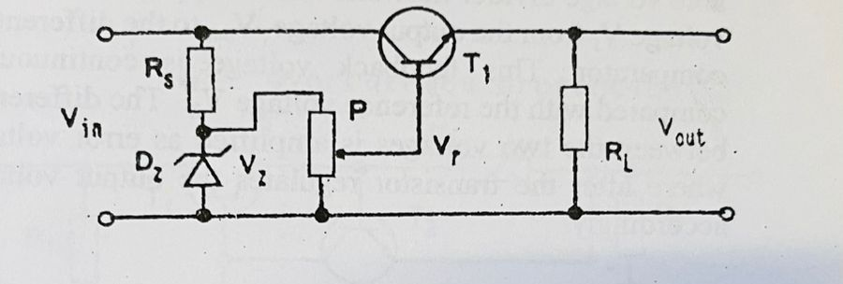
Series voltage regulator with adjustable ref source

Slide 22
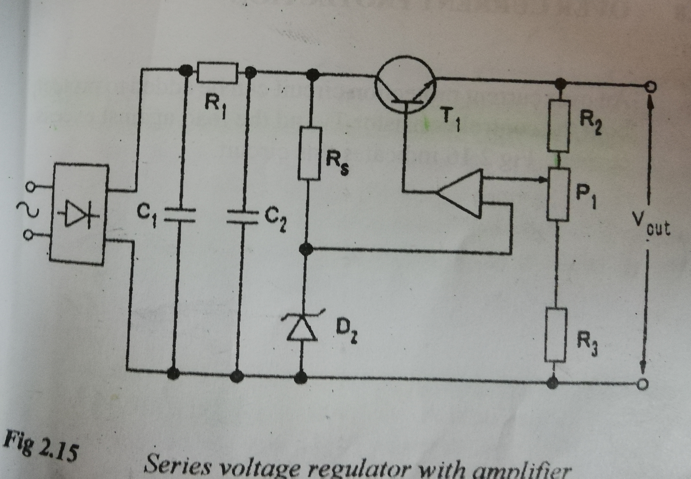
Operation of a series voltage regulator with amp
Consider figure 2.15 on page 2.19 as it will have one of the input connected to the potentiometer.
The Pot serves as a voltage divider which makes the reference voltage adjustable.
For the circuit to be stable, a feedback network with a comparator is added. Figure 2.15
The pot together with R1 and R2 form an adjustable voltage divider network which supplies a feedback voltage from the output voltage to the differential amp.
This feedback is continuously compared with the reference voltage from the reference device.
The difference between the two voltages is amplified as error voltage.
The transistor then regulates accordingly.

Slide 23
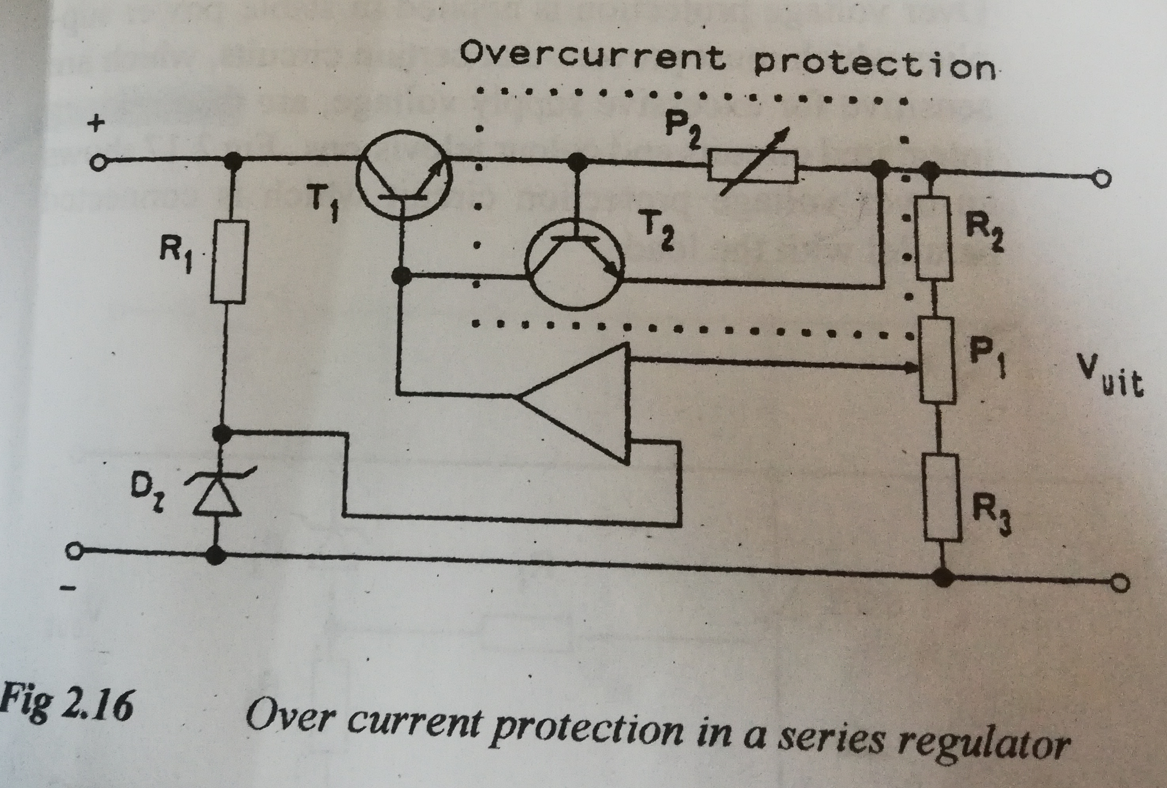
Operation of an over current protection
Refer to figure 2.16 on page 2.21 or the above figure
This will protect the device against excessive currents which may damage the control element.
An edition of a second transistor and potentiometer achieved.
This is how the protection is achieved
During overload conditions, the increased voltage drop across P2 will switch T2 on to conduct a part of the base current of T1 and therefore limits the increase in load current to a safe value.
The value at which P2 is set, determines the maximum load current which may flow.
P2 must have low resistance with high power rating.

Slide 24
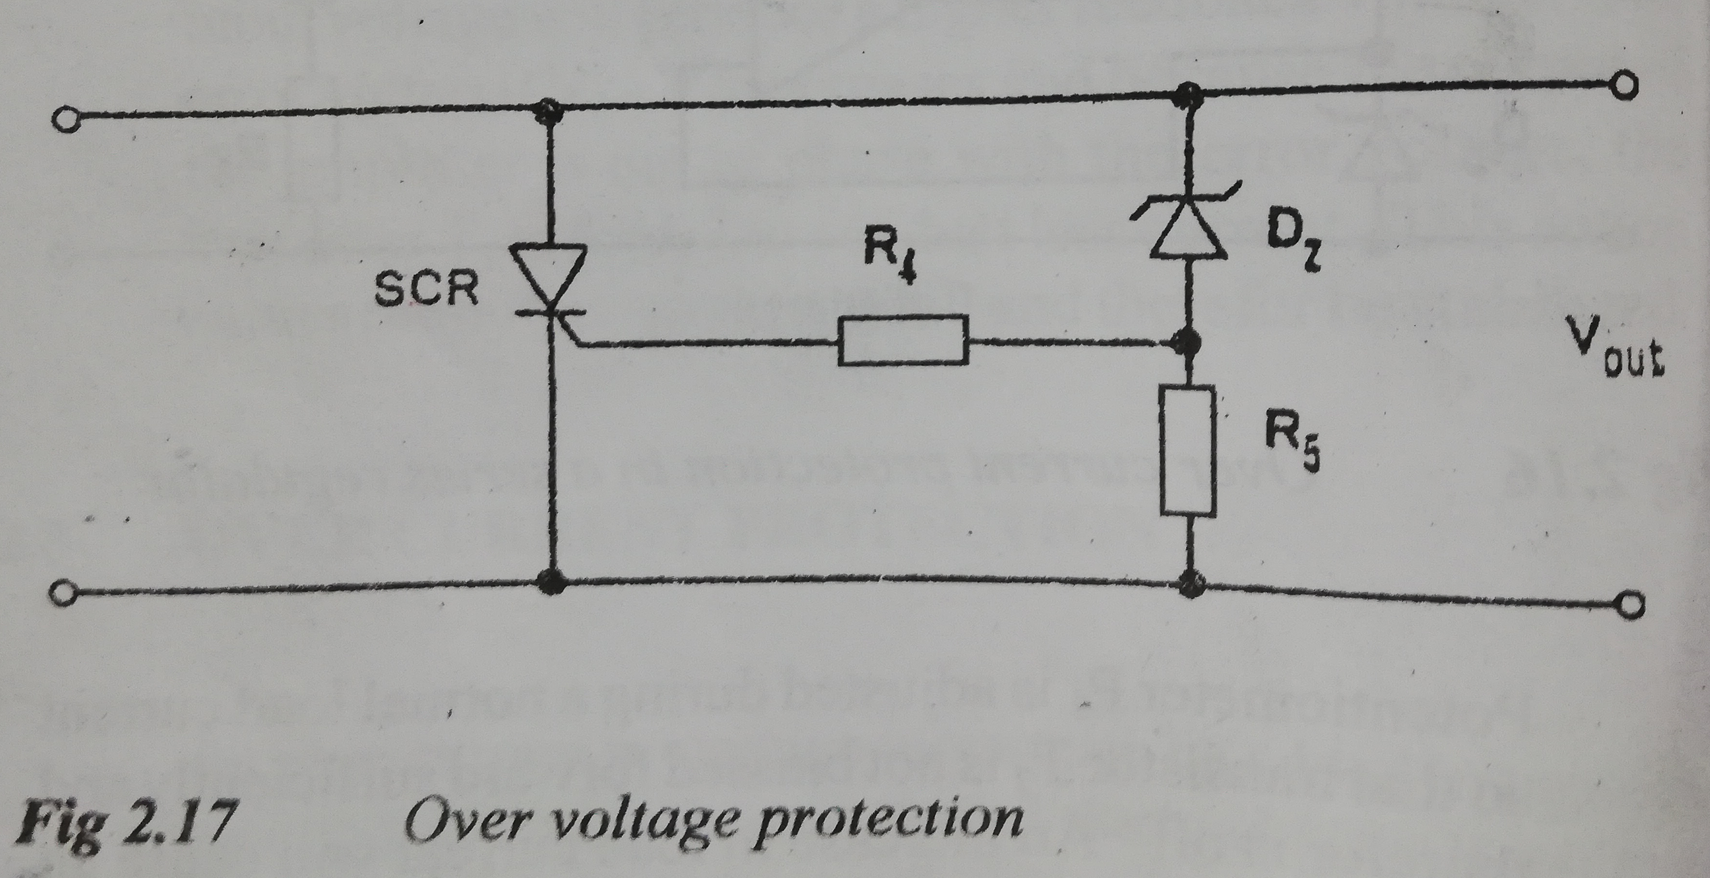
3.Operation of an over voltage protection
Refer to figure 2.17 on page 2.22 or on the above figure.
The value of the diode and R5 determine the maximum allowable output voltage that may appear across the load.
As soon as the maximum allowed voltage is exceeded, the voltage drop across the Zener will stay constant while that across R5 increases.
This voltage is high enough to trigger the gate of an SCR and it switches on, the output voltage drops to zero.

Slide 25
4. activity
Exercise 2
On page 2.34, do exercise number 13,14 and 18
Refer to filter notes activities on previous slide
( The above activity will help you understand your notes)

Slide 26
20. ADJUSTABLE POWER SUPPLY
Adjustable power supplies are used for the testing of circuits.
They make used of series voltage regulators whose output voltage is in fact adjustable through an addition of a potentiometer and some resistors which form a potential divider.
The output voltage can either higher or lower than the supply voltage.

Slide 27
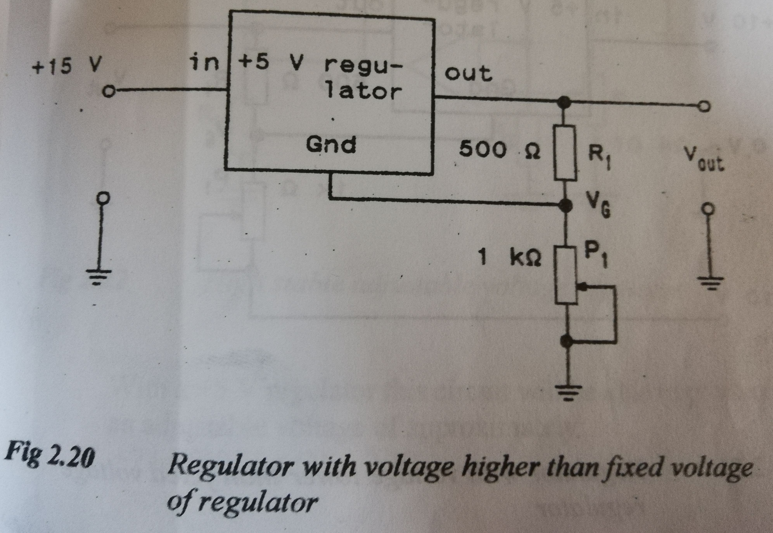
21. Reg with higher voltage
The Regulator with voltage higher than fixed voltage of regulator

Slide 28
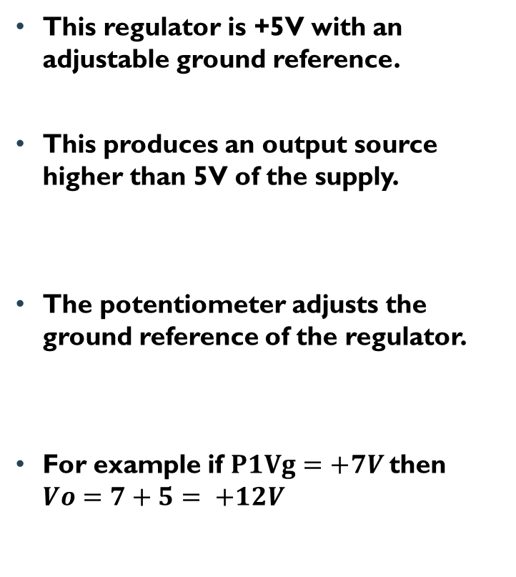
22.Reg with higher voltage than fixed voltage
This regulator is +5V with an adjustable ground reference.
This produces an output source higher than 5V of the supply.
The potentiometer adjusts the ground reference of the regulator.
For example if $P1Vg=+7V$then $Vo=7+5= +12V$

Slide 29
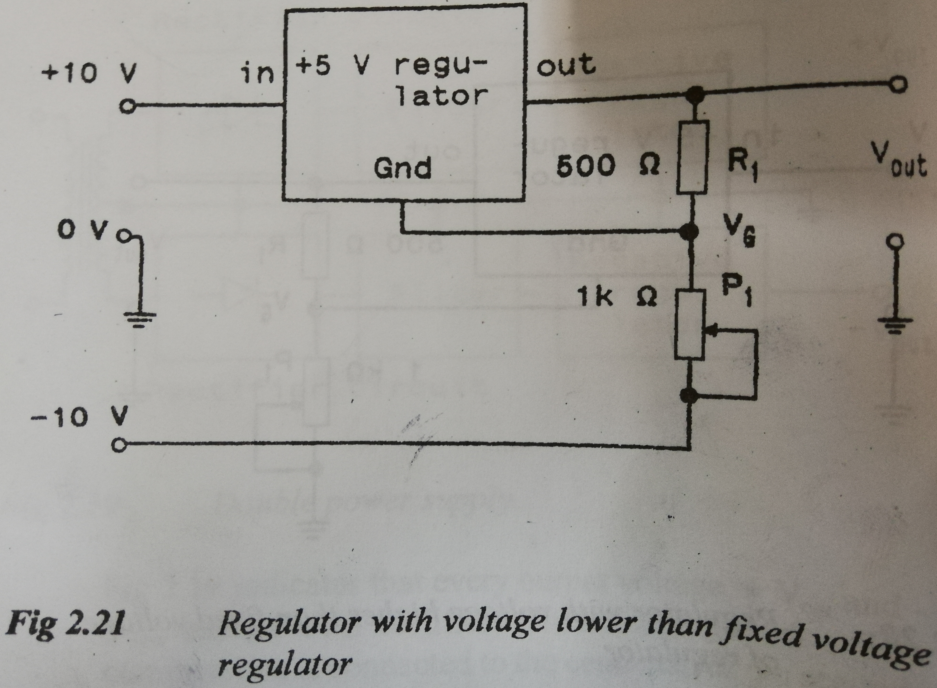
23.Reg with voltage lower than fixed
Regulator with voltage lower than fixed voltage

Slide 30
24. activity
Exercise 2
Show in a circuit diagram how a 5 V fixed voltage regulator can be used to produce an adjustable output of +7 V to +30 V
( The above activity will help you understand your notes)

Slide 31
25.Regulator with voltage lower than fixed voltage
Refer to figure below
The output voltage will be lower than the input voltage
If for example 2V is required at the output, Vg must be adjusted to -3V.

Slide 32
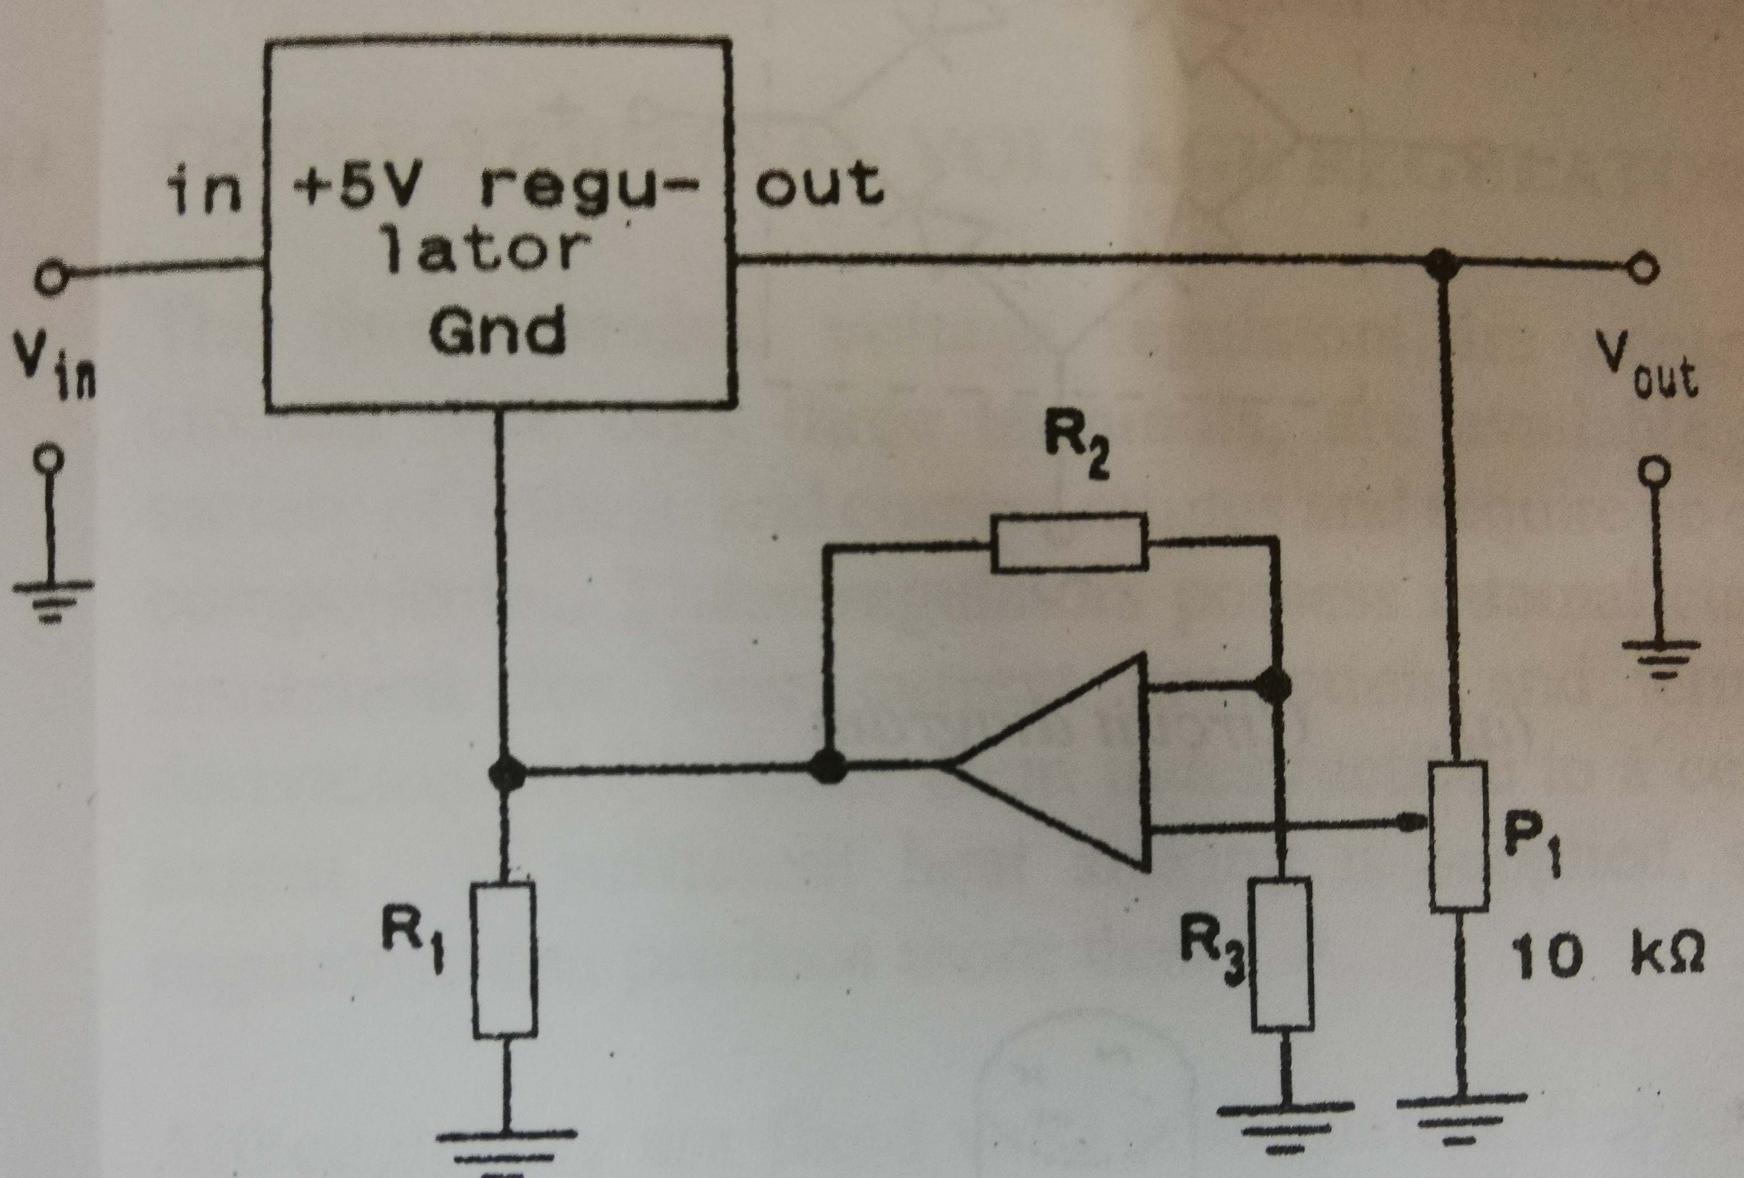
26.High adjustable reg
High adjustable voltage regulator

Slide 33
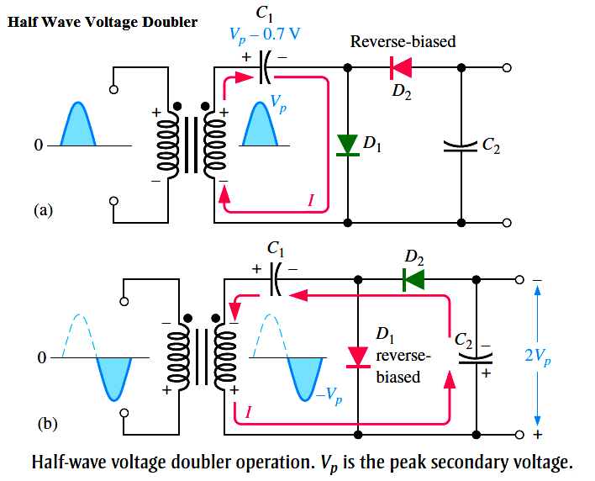
Operation of a half wave voltage doubler
Consider figure (a) and follow the red line;
  During the positive half cycle of the transformer, D1 conducts while D2 is reversed biased.
  C1 charges to maximum voltage of Vm and the voltage across C2 is zero.
  During the negative half cycle across the transformer, D2 conducts while D1 is reversed biased.
  C1 is prevented from discharging because D1 does not conduct and therefore keeps its charge.
  This makes C2 to charge to 2Vm
Refer to page 2.11 to 2.12

Slide 34
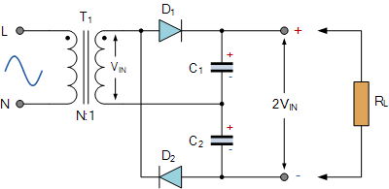
Operation of a full wave voltage doubler
Refer to figure 2.8 on page 2.12 or the above figure
During the positive half cycle across the transformer;
    D1 conducts and D2 is off.
    C1 charges to a voltage of Vm
During the negative half cycle across the transformer;
    D2 conducts and D1 is off
    C2 charges to a voltage of Vm
    The total voltage across both capacitors will be 2Vm.

Slide 35
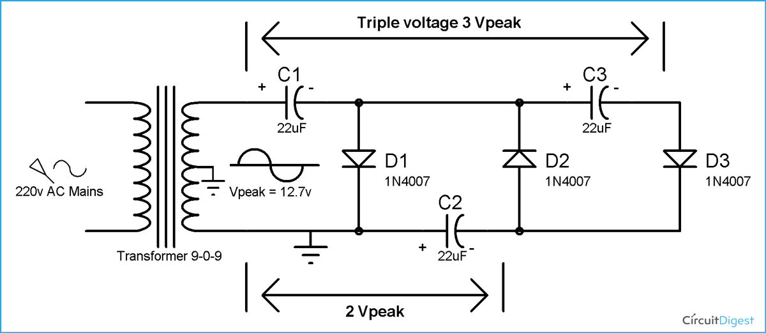
Operation of a voltage tripler
Refer to figure 2.9 on page 2.13 or on the above figure.
During the positive half cycle;
    D1 conducts and C1 charge to Vm
During the negative half cycle;
    C2 charges to 2Vm, C3 charges to a voltage of 2Vm
the total voltage drop across C1 and C2 will be 3 Vm

Slide 36
33. examples
Example 01
Refer to example 2.1 on page 2.10
Refer to example 2.2 on page 2.17

Slide 37
34. activity
Exercise 2
On page 2.34, do exercise number 11,12,13 and 16
( The above activity will help you understand your notes)

